Slide 1
Ready for MaaS?
Easier mobility for citizens and better data for cities
Martin Röhrleef
ÜSTRA Hannoversche Verkehrsbetriebe AG
Head of Mobility Innovation
@TwitterAccount

Slide 2
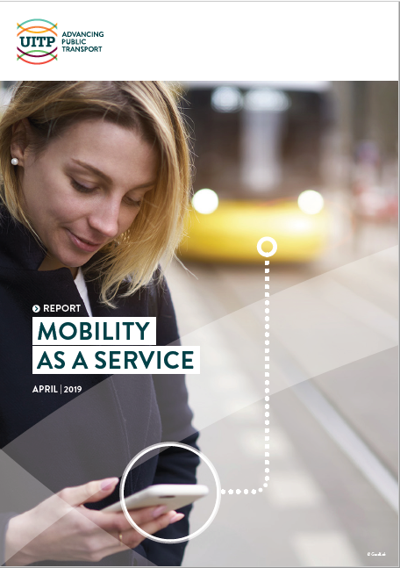
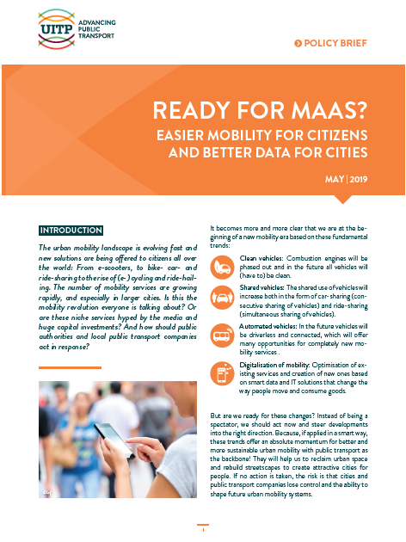
Get your Free copy on the UITP Stand
UITP MaaS Report & Policy Brief

Slide 3
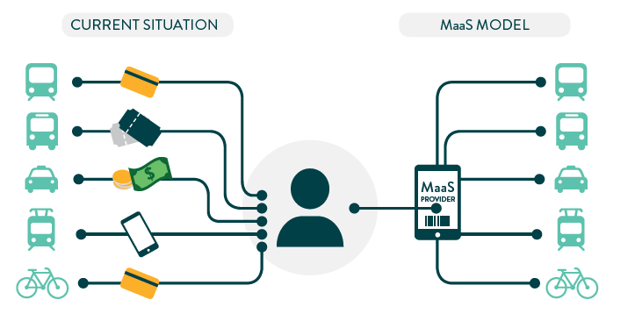
What is maas? - UITP Definition
Mobility as a Service (MaaS) is the integration of, and access to, different transport services in one single digital mobility offer with active mobility and an efficient public transport system as its basis.
This tailor made service suggests the most suitable solutions based on the user's travel needs. MaaS is available anytime and offers integrated planning, booking and payment, as well as, en route information to provide easy mobility and enable life without owning a car.

Slide 4
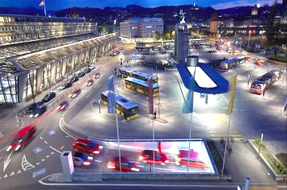
Why Is Maas interesting?
Mega trends in mobility are boosting MaaS
Advantages for all stakeholders
User: complete and easy mobility
City: helps to shape travel behaviour towards more sustainable modes
PT: more customers and higher revenues

Slide 5
Creating a user centric experience
Usability and Trust are the keywords
Simplicity: easy, user-friendly, convenient service
High quality: correct information, reliability
Impartiality: present mobility options in a transparent way
Flexibility: personalized service adapted to customer needs
EXTRA VALUE
Notes:
The key expectations of a traveller for an integrated mobility service are trustworthiness, simplicity, low-threshold accessibility, impartiality, flexibility and personalization:
In order to trust a service it should guarantee a high level of quality, offer correct real time information, have a strong reputation/brand and offer reliable transport services. It should also be simple, meaning an easy, user-friendly, convenient service offering a single sign-on access with integrated information before, during and after the trip and helping the traveller in the decision-making process by reducing the cognitive load. Impartiality is another requirement as MaaS should be non-discriminatory and present all available mobility options in a transparent way. Flexibility is important, as the service must be able to adapt to changing traveller’s needs and it should be personalized in order to take into account personal preferences.

Slide 6
Building a strong partnership
MaaS is all about collaboration
There must be a value for every partner
Reciprocity & data deals
Providers may keep their customer relationship

Slide 7
Who takes which role within the eco-system?

Slide 8
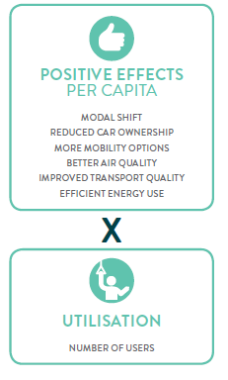
Role of the Integrator Who can make it fly?
Notes:
Indeed, the role of the integrator is to make it fly. The integrator needs to set up an integrated mobility platform that attracts a large number of customers and that creates value for the business partners (mainly the transport operators) and satisfies their expectations.
Only by having happy customers and happy business partners will a MaaS integrator be able to scale and create maximum benefits for sustainable mobility. Depending on the local context, taking into account many factors such as the strength of established mobility services, the openness of the travellers, the institutional organization and legal framework for the transport services and many more, this role could be taken by different actors such as the public transport authority, any transport operator, a tech firm, a MaaS company or any other actor from the banking or the telecommunications sectors

Slide 9
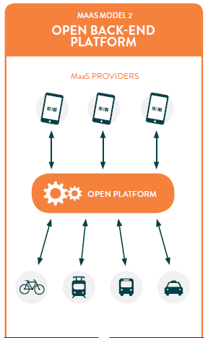
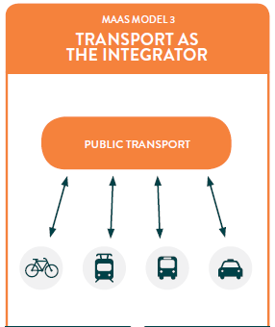
Different MaaS Models
Notes:
In the MaaS Model 1, a commercial integrator acts in the context of a marketplace with bilateral agreements between the MaaS provider and the transport operators. There would be competition and there are no specific regulations. This Model could be perceived as providing a more customer oriented and innovative solution, but doubts persist on whether it would be socially inclusive. Data would probably not be shared with public authorities making the enhancement of existing public transport services and planning thanks to data analytics impossible. The risk of a bias in the presentation of the transport options is perceived as high.
A variation of this Model could be that all transport providers, private or public are forced by law to open up their data and API’s so that their services can be resold by third parties. This model favours a more rapid development of market solutions, but without reselling licenses and the sharing back of data to transport operators and authorities the same risks arise.
In the Maas Model 2, an open back-end platform would be set up by a public entity with rules determined by the public authority. The platform would serve as public infrastructure on which different actors could build a MaaS solution. All mobility services have to open up their API’s to be integrated in the platform. This model would be leaving room for competition to get the most customers and it is perceived as offering the possibility to provide a customer-oriented, innovative and neutral service. It would also integrate local mobility providers. The financing of the open back-end platform needs to be addressed.
In MaaS Model 3, public transport would be the integrator. Indeed since public transport already has the largest customer data base and is the backbone of sustainable urban mobility, it makes sense to take the lead in integrating other mobility services. This would help public transport to stay relevant towards existing customers and be more attractive to new ones by becoming a real mobility provider. This model is perceived as being able to achieve the highest increase in sustainable mobility, be socially inclusive and best aligned on public policy goals as data would be shared with public authorities. But this model could also be perceived as possibly providing a less customer oriented and less innovative service.

Slide 10
Conclusion
MaaS will become the future business model in transportation
MaaS can be a brilliant tool for more sustainable mobility - if deployed around mass public transport & active modes
Different approaches possible
Let’s make sure MaaS is the desired tool that cities can use to build a more sustainable future!

Slide 11
Recommendations
Setting up successful MaaS solutions
Start to build the eco-system
Ensure public transport and active mobility options are at the centre of any MaaS solution
Care about data reciprocity & data protection
Make use of the data to optimize the urban mobility offer
Adopt and harmonise quality standards for all mobility providers
Foster innovation by funding

Slide 12
Recommendations
Build up institutional and policy integration
Overcome institutional fragmentation with mobility agencies or multimodal transport authorities in charge of all urban mobility services
Encourage multimodal urban planning for the development of mobility hubs and multimodal infrastructure
Include MaaS as a catalyst to reach policy goals (SDG)

Slide 13
Recommendations
Create the right framework to promote MaaS
Stop wrong incentives that support car use and thus hinder sustainable mobility behaviour and MaaS (free parking, company cars, …)
Increase measures to limit car use (access restrictions, road pricing, parking restrictions, street reclaiming…)
Invest in digital solutions that promote integration and openness.

Slide 14
Get your Free copy on the UITP Stand
UITP MaaS Report & Policy Brief

